Slide 1
Definition: Reflector Antenna
The reflector is a metallic surface formed into a paraboloid of revolution and (usually) truncated in a circular rim that forms the diameter of the antenna.
This paraboloid possesses a distinct focal point by virtue of having the reflective property of parabolas in that a point light source at this focus produces a parallel light beam aligned with the axis of revolution.

Slide 2
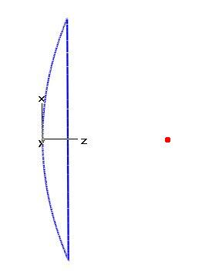
New macro: Reflector Antenna
Sets the Units to cm, Ghz, ns.
Sets the Boundary Conditions to Open Add Space.
Creates a parabolic dish with the following parameters:
  D. Reflector diameter;
  focus. Focal length of the reflector;
  th_true. If set to 0 the dish has not thickness;
  th_dish. Thickness of the reflector.
The focal length “focus” (distance of focal point from the center of the reflector) is calculated with the following equation:
  d=D²/(16*focus)
where d represents the depth of the antenna.
Returns the coordinates of the focal point by means of a PickPoint.
D
focus

